Slide 1
Street View House Numbers Image Recognition
Celine Li and Kevin Liu
August 26，2019

Slide 2
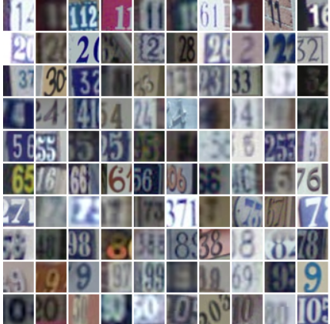
Background
Dataset:
Various types and colours of street numbers on various backgrounds
73,257 images for training, 26,032 images for testing
Objective:
Effectively recognize the single digits that’s entirely present in the images
Exploring the effectiveness of using support vector classification (SVC), Logistic Regression, K-nearest neighbours (KNN) classification, Random Forest, Ensemble Stacking, and convolution neural networks (CNN), for number recognition in the images
Dataset source: http://ufldl.stanford.edu/housenumbers/

Slide 3
Exploration and Preprocessing of Data
The format of the dataset is “MNIST-like 32-by-32 images centered around a single character (many of the images do contain some other digits at the sides)
The original pixel values are from 0 to 255
Two workbooks were created: one for Ensemble Methods, and one for CNN
To make fair comparisons between the model performances, the same preprocessing code was used at the beginning of both notebooks:
Images were first converted from red, green, and blue (RGB) to greyscale
Linearly scaled each pixel value in the image to be in the range of 0 to 1
Notes:
For each image in the original dataset, we converted it from red, green, and blue (RGB) to grayscale, using a weight of 0.3, 0.6 and 0.1 on the RGB value respectively. Then we scaled each pixel value in the image to be in the range of 0 to 1. The original pixel values are from 0 to 255, which may be harder for the neural network to deal with. We applied simple linear scale by dividing by the max value of 255.

Slide 4
Classifiers Used For Ensemble Methods
Support Vector Classifier (‘rbf’)
Logistic Regression
Random Forest
K-Nearest Neighbors
Notes:
The classifiers used in the first half of the project are K-Nearest Neighbors, Logistic Regression, Support Vector Classifier, and Random Forest.
In the second half, we introduce convolutional neural networks to compare the effectiveness of these algorithms

Slide 5
Support Vector Classifier
Achieved approximately 67% accuracy on the test set in initial run
Improved accuracy to 71% after under-sampling training set and performing random search for optimal C and gamma values
Accuracy may have been further improved by combining extra image set with training set
Notes:
First we look at Support Vector Classifiers. Before any additional preprocessing beyond the initial conversion to grayscale, rescaling, and resizing the data, running a support vector classifier with a radial basis function kernel resulted
In a test accuracy of 67%. However, we were then able to improve this number to 71% accuracy after under-sampling the training set by removing samples from each class until the number of samples are even throughout all 10 classes. We also performed a random search for optimal hyperparameters, and found that a gamma value of 0.000001 and C value of 10 provided the highest performance, although we did not search through every possible hyperparameter combination.
2. The accuracy could have been further improved if we included the extra set of images in our training set, but the runtimes would have increased significantly. (the time it takes for a grid search with 13 hyperparameters was approximately 9 hours)

Slide 6
K-Nearest Neighbors and Logistic Regression
Both K-nearest neighbors and logistic regression, although had somewhat decent training accuracy (70%), sported very low test accuracies (<50%)
Did not search for optimal k parameter due to long processing time
From confusion matrix, a majority of misclassifications had result of “1”
Some 6’s were misclassified as 8’s
Stacking these models with SVC and random forest improved accuracy, but was much worse than just SVC + random forest

Slide 7
Random Forest
A built-in SciKit Learn ensemble classifier consisting of a multitude of decision trees
Also performed at around 71% accuracy on test set with optimal searched parameters (1,000 trees)
Accuracy may be increased by increasing the number of trees (n estimators)

Slide 8
Stacking Ensemble
Stacked SVC with Random Forest to increase precision
Test accuracy remained around 71%
Test accuracy remained more or less similar after stacking with RBF SVC – may have increased if more models were included

Slide 9
Model Comparison
Model | Test Accuracy
Support Vector Classifier (‘rbf’) | 71%
K-Nearest Neighbours | 46%
Logistic Regression | 17%
Random Forest | 71%
Stacking SVC with Random Forest | 71%

Slide 10
Future Improvements
Oversampling the training data by including the extra set to provide more samples
Optimize parameters by grid / random search for all classifiers
Increase number of pixels (64x64 or 100x100)

Slide 11
Convolutional Neural Network (CNN)
The core of the CNN model are 3 convolutional layers, each followed by a Max Pooling and Leaky ReLu activation
After the convolutional layers is a fully connected dense layer, allowing information extracted by the convolutional layers to be used all together, and followed by dropout of 0.4, and ReLu activation
At the end of the network, there is the Softmax layer that outputs the probability for each class
To compile the model, “Adam optimizer” was used since it includes many optimizations
Overall final model achieved a 92% test accuracy
Notes:
CNN method is a Deep learning algorithm that can take an input image and assign importance to various aspects in the image in order to differentiate one from another [3]. The benefit of the CNN method is that is efficient in recognizing patterns and key features in images as it is not a fully connected neural network, but still contains multiple convolution layers (the kernels) which are used to “filter” the images.
The challenges with applying the CNN method are potential overfitting, and also it requires a large amount of training data in order to perform well.

Slide 12
Parameters vs Performance
Epochs | Depths and Activation of each CNN layer | Dense Layer # Neurons | Test Accuracy | Result & Comments
5 | (32, 64, 64; ReLu) | 64 | 90.32% | Good initial performance
5 | (32, 64, 64; Leaky ReLu α=0.1 ) | 64 | 90.73% | Leaky ReLu performs slightly better
5 | (64, 128, 128; Leaky ReLu α=0.1) | 64 | 91.03% | Increased depths performs better
5 | (64, 128, 128; ReLu) | 64 | 89.67% | Leaky ReLu performs slightly better
5 | (64, 128, 128; Leaky ReLu α=0.1) | 128 | 90.81% | Overfit from increased dense layer neuron
5 | (32, 64, 64; Leaky ReLu α=0.1) | 128 | 90.83% | Still overfit from increased dense layer neuron, will stick to 64
10 | (32, 64, 64; Leaky ReLu α=0.1) | 64 | 90.68% | Epoch =10 lead to overfitting
10 | (64, 128, 128; Leaky ReLu α=0.1) | 64 | 90.97% | Epoch =10 lead to overfitting
5 | (64, 128, 128; Leaky ReLu α=0.2) | 64 | 91.01% | No significant difference than α=0.1
5 | (32, 64, 64, 64; Leaky ReLu α=0.1) | 64 | 90.07% | 4 layers led to overfitting, so will stick with 3 layers

Slide 13
Addition of Dropout Reduced Overfitting
The performance comparison between the same CNN layers with different dropout for epoch =5 and 10
Dropout rate | Epoch = 5 |  | Epoch = 10
 | Training Accuracy | Testing Accuracy | Training Accuracy | Testing Accuracy
None | 94.57% | 91.03% | 96.24% | 90.97%
0.2 | 92.25% | 90.41% | 94.75% | 91.03%
0.3 | 91.81% | 91.16% | 94.15% | 91.70%
0.4 | 91.12% | 91.25% | 93.60% | 91.88%
0.5 | 90.36% | 90.77% | 92.96% | 91.63%

Slide 14
Findings and Future Improvement
Findings
Leaky ReLu does not always perform better than ReLu
Dropout is an effective way to mitigate overfitting in CNN
Future Improvement
If computational power allows, perform more grid searches on the number of epochs as well as the number of neurons for each layer to see if test performance can be further improved.

Slide 15
Final Model Comparison
Model | Test Accuracy
Logistic Regression | 17%
K-Nearest Neighbours | 46%
Support Vector Classifier (‘rbf’) | 71%
Random Forest | 71%
Stacking SVC with Random Forest | 71%
Convolutional Neural Network | 92%
Notes:
The CNN model with 92% test accuracy on the Street View House Numbers Image dataset performs significantly better than Ensemble Method with 71% test accuracy. Thus, the final model proposed for this project is the CNN model. Although the challenge of CNN model overfitting has impacted its performance, but with the use of dropout parameter, we have mitigated overfitting and produced a satisfactory model.

Slide 16

Questions?

Slide 17
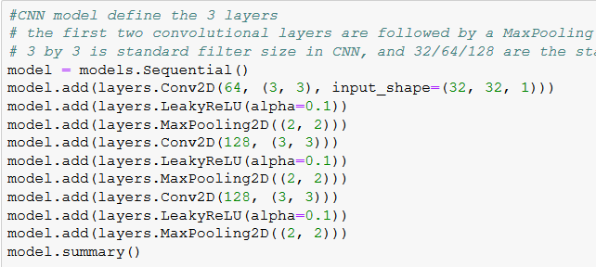
Back up Slide on CNN Model

Slide 18
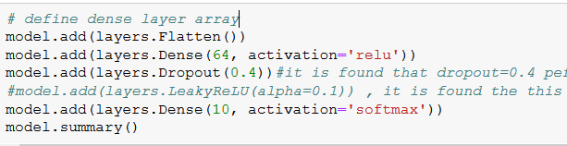
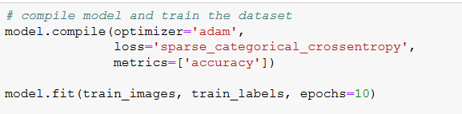
Back up Slide on CNN Model

Slide 19
Back up Slide on Random Forest
Model | Hyperparameters Searched | Final Hyperparameters
Random Forest | N_estimators = [500, 700, 900], max_features = “auto”, max_depth = [1,5,10], min_samples_split = [3, 5], min_samples_leaf = [1, 2, 4], bootstrap = [True, False] | N_estimators = 1500, max_features = “auto”, min_samples_leaf = 1
Random Forest w/ Rand Search |  | N_estimarors = 900, max_features = “auto”, min_samples_leaf = 1, max_depth = 10, min_samples_split = 5
K-Nearest Neighbors | None | N_neighbors = 2
SVC RBF | Gamma = [0.00001, 0.0001, 0.1], C = [1, 10] | Gamma = 0.000001, C = 10
Logistic Regression | None | Multi_class = “ovr”, solver = “lbfgs”
Stacking SVC with Random Forest | None | Voting = “hard”

